Slide 1

Terrathede Games Information

Slide 2
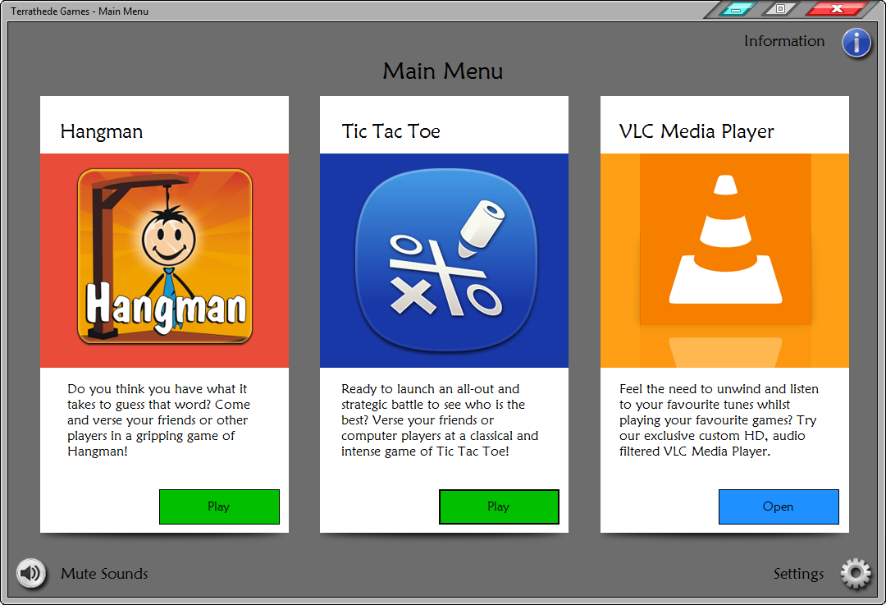
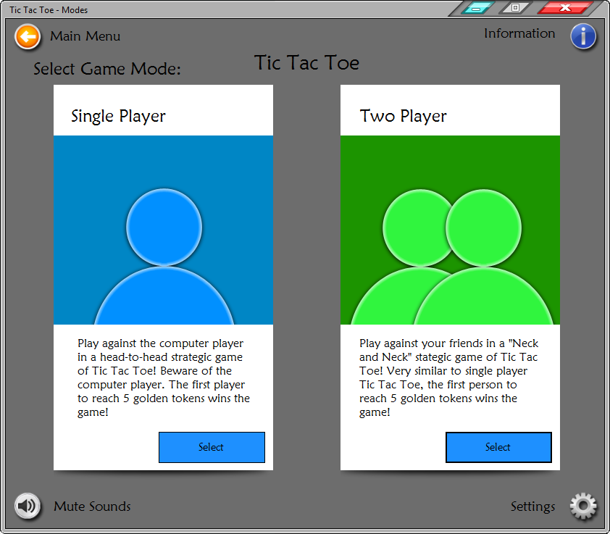
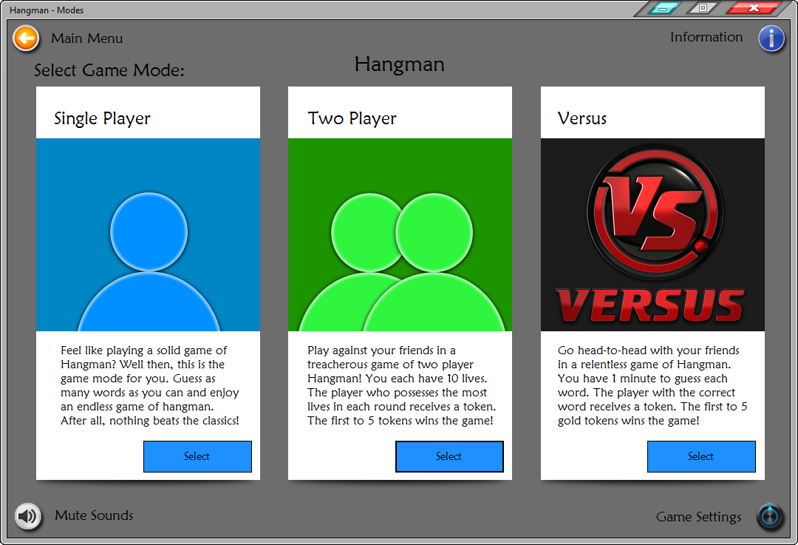
Table of Contents:
(Click to Choose):
Main Menu
Hangman
Tic Tac Toe
Settings

Slide 3
Main Menu:
In order to navigate through the main menu, you must first familiarise yourself with the layout of the menu. There are three options to choose from:
  Hangman
  Tic Tac Toe
  VLC Media Player (Separate Program)
  Settings

Slide 4
Hangman
Contents Page:
Selecting Game Mode
Single Player
Two Player
Versus
Editing the Word List
On-Screen Keyboard
Game Over
Next

Slide 5
Selecting Game Mode
Once in the Hangman Mode Menu, select which game mode you wish to play. Then select from below, how to play that game mode:
Single Player
Two Player
Versus

Slide 6
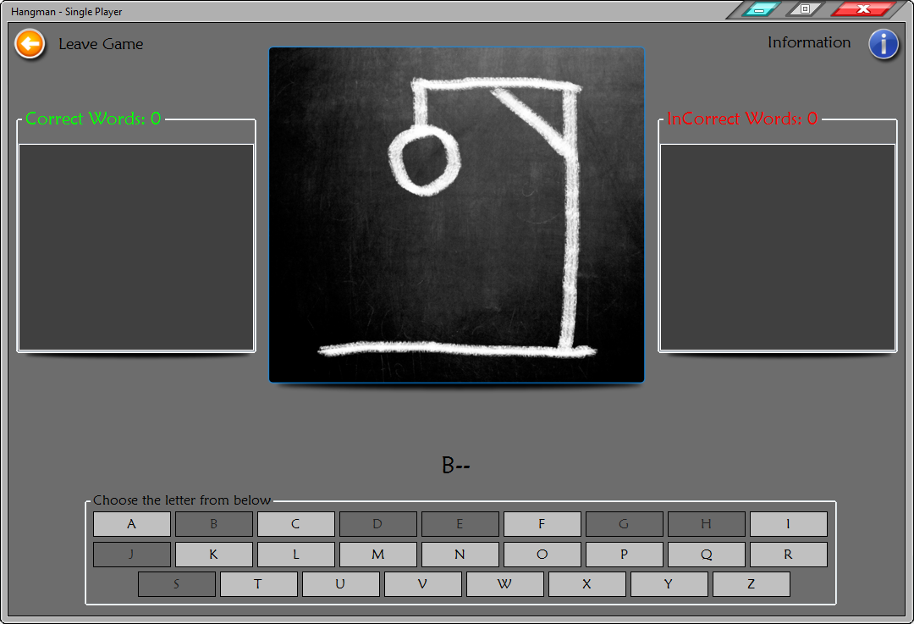
Single Player
Click the “Start” button to start the game and a word will be randomly generated.
Select a letter of which you might think would be in the randomly generated word.

Slide 7
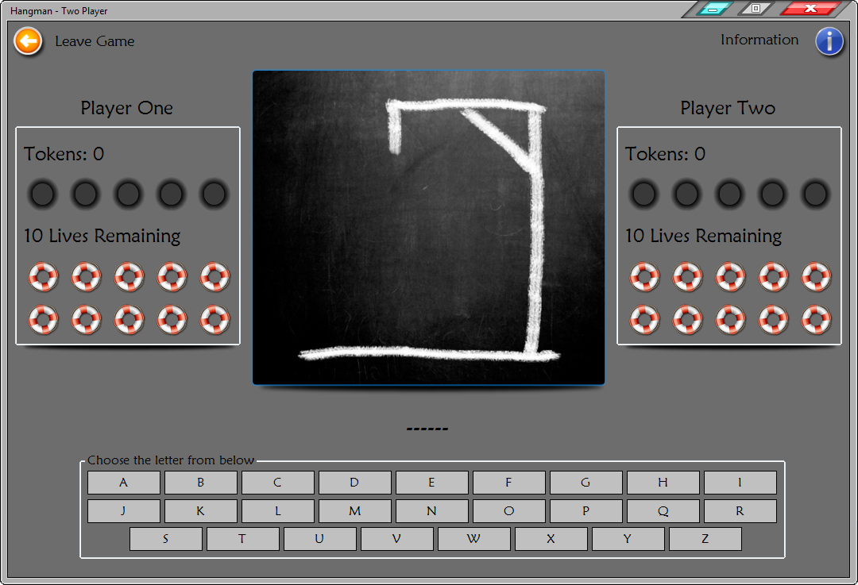
Two Player
Upon selecting Hangman – Two Player, you will be prompted to enter you and your opponent’s name. Enter your names to proceed to the game.
Once in the game, player two must enter a word for player one to guess.
The player who has the most lives at the end of the round wins a golden token.
The player who reaches 5 golden tokens wins the game.

Slide 8
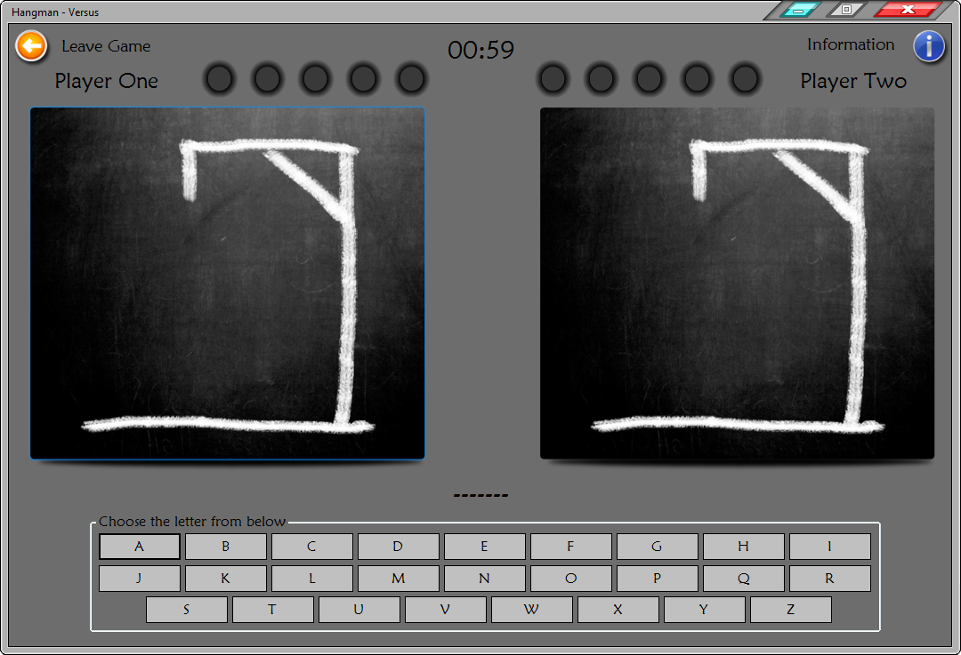
Versus
Upon entering the game mode (like in Two Player) players must enter their names into the application (if you have not already done so).
When proceeding to the game, click on the “Start” button to begin the game and watch as both game boards count down from 5. Once the counter reached 0, you both need to quickly guess the word within a 1 minute duration
The player who guesses the correct word in the elapsed time, gets a token.
(Just like in Two Player) The player who received 5 golden tokens, wins the game.
Next

Slide 9
Editing the Word List
To edit the word list, you need to first navigate back to the Hangman Mode Menu and select the “Game Settings” button at the bottom right hand corner of the window.

Slide 10
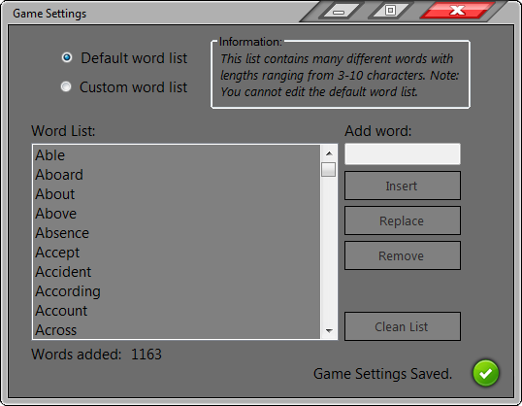
Editing the Word List
In order to edit the word list correctly, you need to select the “Custom Word List” option.
Once you have selected this option, the buttons should enable themselves.
Now you can edit the word list.
Note: Words need to be between the lengths of 3 – 21 characters and no signs or symbols are to be entered.

Slide 11
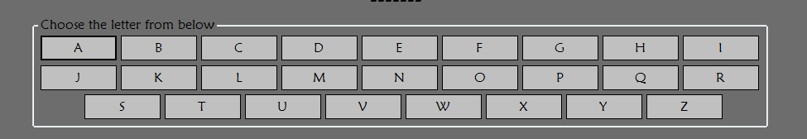
On-screen Keyboard
To Guess letters you will have an onscreen keyboard which you can click to choose a letter to guess. Note: This is shown on all game modes of Hangman

Slide 12


Game Over
Once the game is over in hangman game modes (except for single player) you each will be presented with a prompt such as the following:

Slide 13
Tic Tac Toe
Contents Page:
Objectives
Selecting Game Mode
Single Player
Two Player
Game Over

Slide 14

Objectives
In both games of Tic Tac Toe (Single Player and Two Player) The objectives are very simple.
The goal is to obtain 5 tokens first in both games of Tic Tac Toe
Once the threshold has been met (5 golden tokens) and you have obtained them before your opponent, then you have won the game.

Slide 15
Selecting Game Mode
Once entered in the Tic Tac Toe Mode Menu, you’ll notice that you only have two game modes in Tic Tac Toe (no versus).
Choose between either game mode.

Slide 16
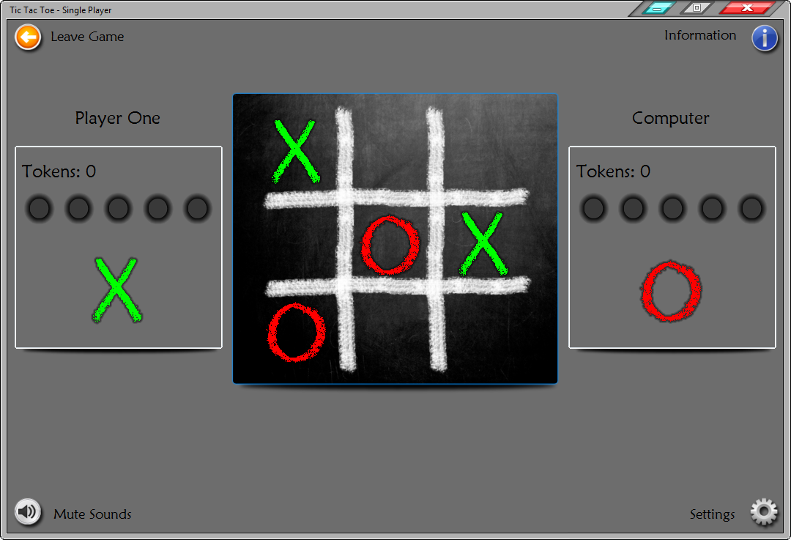
Single Player
In Single Player, you are always the “X” marker whereas the computer player is always “O”.
Place your marker in any place of your own choosing and the computer player will take it’s turn automatically.
Repeat these methods in order to see who reaches 5 golden tokens first.

Slide 17
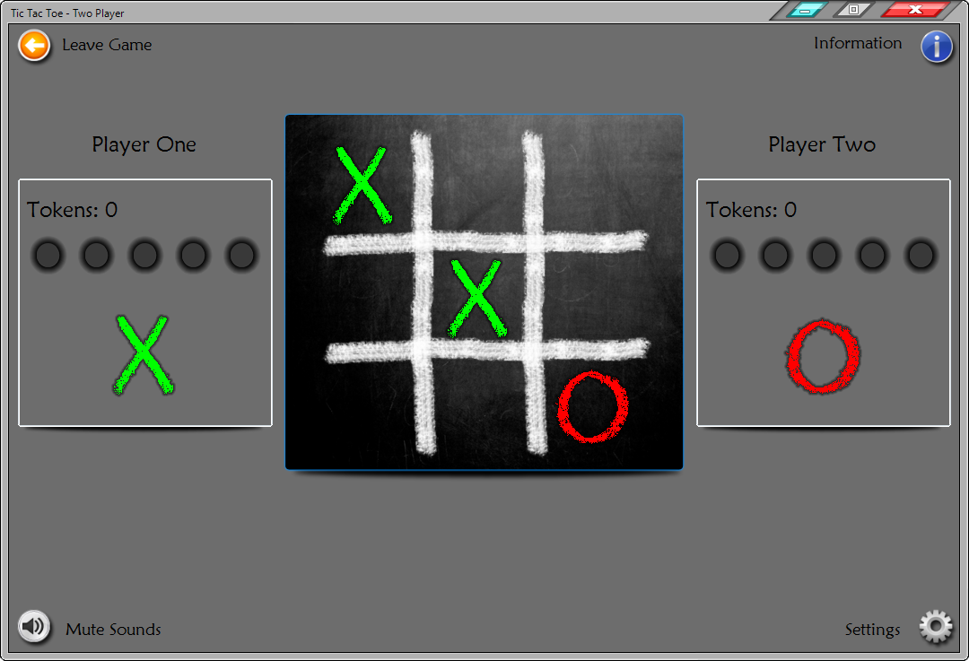
Two Player
Upon entering this game mode, you will be prompted to enter both Player One’s name and Player Two’s name.
Once in the game you will be presented with an ordinary Tic Tac Toe board. Player One, select the place you wish to set your marker.
Player Two, select the place you want to set your marker.
Repeat these steps until one of you places your markers in a row of 3, diagonally, horizontally or vertically to receive a token.
As soon as one of you reach 5 golden tokens, that player wins the game.

Slide 18
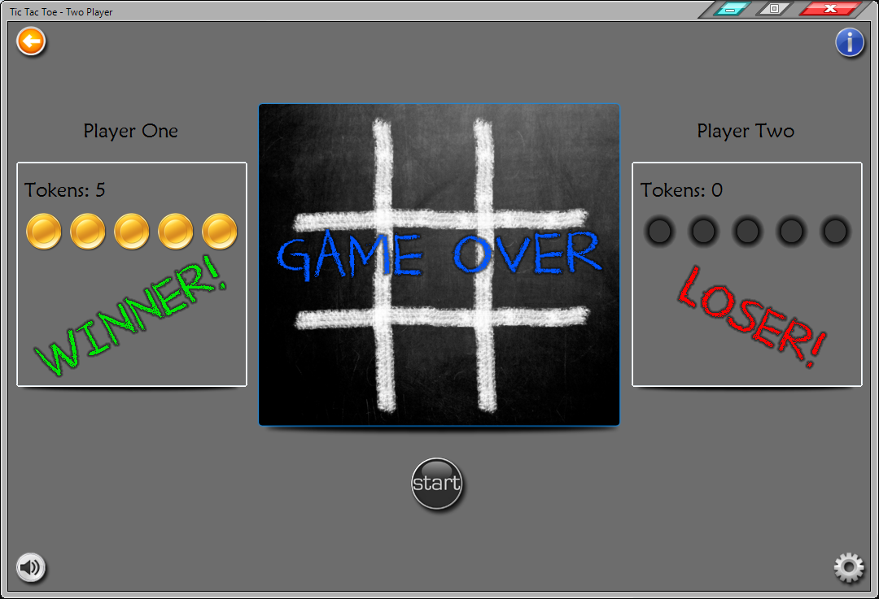
Game Over
As soon as the game is over and one of the players has received 5 golden tokens, players will be presented with a huge “Game Over” prompt in the middle of the board.
The prompt should look like this:

Slide 19
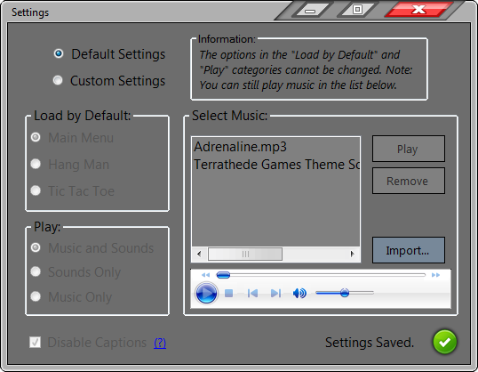
Settings
Contents Page:
Default/Custom Settings
Load by Default
Play settings
Disable Captions
Select Music
Prompts

Slide 20
Default/Custom Settings
By choosing between default/custom settings you are disabling and enabling options in the settings window.
Use custom settings to enable the different settings in which you are able to choose from:

Slide 21
Load by Default
Select which form you wish to load by default.
The next time you open/run the program, this window will open up first thing during the start-up process.

Slide 22
Play Settings
You are able to select between Music and Sounds, Sounds Only and Music Only within the “Play” settings.
Music and Sounds: Allows you to listen to both music and sounds in the application.
Sounds Only: Disables the music player so that sounds are only heard.
Music Only: Removes all mute/unmute buttons in the program and enables the music player.

Slide 23
Disable Captions
This option allows you to turn off the effect of button information shown in all windows of the application. Note: There is more information on this option by clicking on the “(?)” link next to the option.

Slide 24
Select Music
This feature allows you to play music whilst in game (Tic Tac Toe Only) or before you enter Hangman.
You are able to “Play”, “Remove” or “Import” .mp3 (Music files) into the program whenever you wish to.

Slide 25
Prompts
As with other windows, there are prompts to indicate different events that occur throughout the use of the program. Once you have chosen any part of the settings to change, it’s worth noting that the application will save every change you make within this feature. Note: The same applies to the “Game Settings” window.

